Slide 1
Inservice Training
Aging Attorneys:
Dealing with
Dementia & Related Issues
David Merrill, MD, PhD
Assistant Clinical Professor
University of California, Los Angeles
Semel Institute for Neuroscience & Human Behavior
UCLA Longevity Center

Slide 2
Overview
Purpose: In-service training
  Dealing with dementia issues in older attorneys
Goals:
  Gain the knowledge to consult with
    Family members, friends, colleagues of older attorneys
  Re: Attorneys experiencing declining mental acuity
    Understand aging, dementia, and related issues
      E.g., medication problems, other health issues
Leave better equipped to render such consultation

Slide 3
Ripped from the headlines:
Many Employees Silent About Mental Health Issues In The Workplace.
The Wall Street Journal (8/29) reports that figures from the National Institute of Mental Health reveal about 25% of US adults may have a mental health issue, and approximately one in 17 may suffer from a truly serious mental disorder, such as bipolar disorder or schizophrenia. The "reasonable accommodation" provision of the Americans with Disabilities Act makes it possible for people with diagnosed mental conditions to work. However, coworkers may not know that their colleagues may have a mental illness. According to Jeffrey P. Kahn, MD, of the Weill Cornell Medical College in New York, "corporations encourage a climate of keeping things under wraps." Employees themselves also may choose to say nothing about their condition for fear that their diagnosis could be held against them and thus prove damaging to their careers.

Slide 4
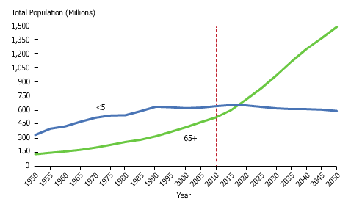
People 65+ to Outnumber Children <5

Slide 5
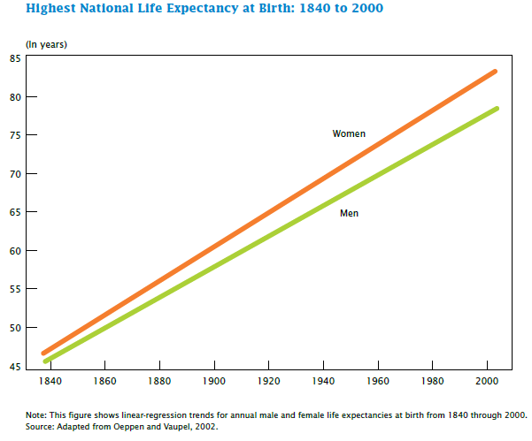
Consistent Rise of Life Expectancy at Birth
Notes:
There has been a consistent rise of life expectancy, about 3 months every year since 1840, increasing the average lifespan from about 45 years in 1840 to 80 years today. Initially, much of this increase was due to things like improved sanitation and treatment of infectious disease, along with decreases in infant mortality.

Slide 6
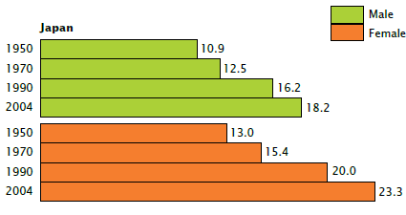
Increased Life Expectancy after Age 65
Life expectancy after age 65:
  15+ years for men
  20+ years for women
How will memory hold up?
Notes:
However, over the past 50 years, there has been a world-wide increase in life expectancy after age 65. Here are graphs showing similar increases from 1950 to today in Japan, the US, and France. Those reaching 65 now can expect to live 16-20 years longer ON AVERAGE. Many people will live substantially longer. In fact, if this 160 year long life expectancy trend continues, it will only be 6 decades until the average life span is 100 years old.

Slide 7
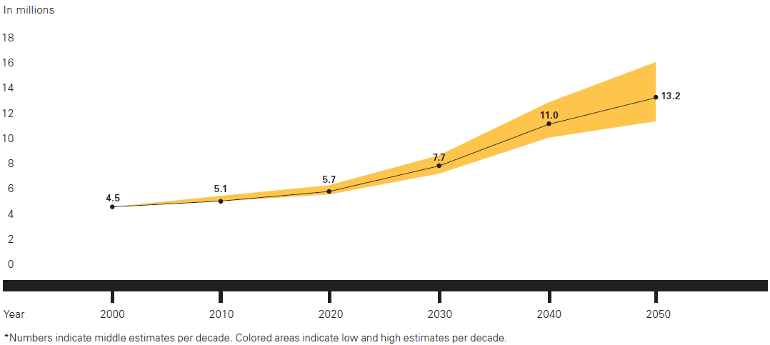
Dementia: Facts and Figures
Alzheimer’s Association: 2012 Alzheimer’s Disease Facts and Figures. Hebert et al., 2003.
Alzheimer’s Disease International, World Alzheimer Report 2010: The Global Economic Impact of Dementia.
Notes:
Currently, 5.4 million people have AD in the US; roughly 1 in 8 older American’s. By 2030, the number of people aged 65 and older with Alzheimer’s disease is estimated to reach 7.7 million —a 50 percent increase. By 2050, the number of people aged 65 and older with Alzheimer’s disease may triple, from 5.2 million to a projected 11 to 16 million.
Cases worldwide:
35 million (0.5%) currently
65 million by 2030
115 million by 2050
Cases in US:
5.4 million
7.7 million in 20 yrs

Slide 8
Dementia: Facts and Figures
Cases in US:
  5.4 million
  7.7 million in 20 yrs
Cases worldwide:
  35 million (0.5%) in 2012
  65 million by 2030
  115 million by 2050
Alzheimer’s Association: 2012 Alzheimer’s Disease Facts and Figures.
Alzheimer’s Disease International, World Alzheimer Report 2010: The Global Economic Impact of Dementia.
Notes:
Nearly 2/3 of dementia cases are in low and middle-income countries, where the sharpest increases in numbers are set to occur.

Slide 9
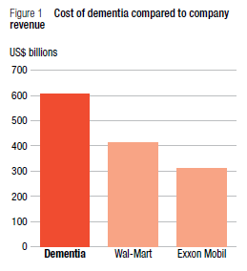
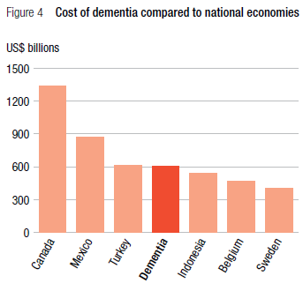
Dementia: Facts and Figures
Alzheimer’s Association: 2010 Alzheimer’s Disease Facts and Figures.
Alzheimer’s Disease International, World Alzheimer Report 2010: The Global Economic Impact of Dementia.
Notes:
If dementia were a company, it would be the world’s largest by annual revenue.
If dementia were a country, it would be the world’s 18th largest economy, ranking between Turkey and Indonesia.

Slide 10
Dementia: Facts and Figures
Total estimated worldwide cost:
  $604 billion
US annual costs:
  $183 billion
Clinical vs. Research:
  $25,000:$100
Alzheimer’s Association: 2010 Alzheimer’s Disease Facts and Figures.
Alzheimer’s Disease International, World Alzheimer Report 2010: The Global Economic Impact of Dementia.
Notes:
Worldwide annual costs: $600+ billion. 70% of costs are in Western Europe and North America. US annual costs: $183 billion. US Federal spending on AD Clinical care vs. Research: $25,000:$100

Slide 11

How does aging occur?
Theories
  Programmed aging
    Genetics dictate rate of aging and longevity: 120+?
  Wear and tear
    Continual injury overwhelms repair capacities
  Use it or lose it
    “The only way you can hurt your body is if you don’t use it”
Notes:
“Godfather of Fitness” Jack LaLanne died at age 96. He had hoped to survive to 100, living proof of his theories and practice of better eating, exercise, and fitness as the way to a long, healthy, life. He began his fitness efforts at age 15 after hearing a health advocate talk.

Slide 12

How does aging occur?
Homeostasis
  The ability to maintain a state of equilibrium (i.e., balance)
    Cellular needs are met
  Each organ plays a role
  Dynamic process
    Vulnerable to stresses
  Exercise
    Builds and maintains
    resistance to stress
    Promotes balance
Notes:
The physiological result of the aging process is a phenomenon called homeostenosis.
Homeostasis – the ability of the organism to maintain a steady state – lessens with time.
With aging, the immune system is less able to mount a strong response to an invading microorganism, and thus it is more difficult to fight infection effectively.
Baroreceptor reflex, which triggers vasoconstriction in order to maintain normal blood pressure, is less robust, and the elderly are less able to respond quickly to intravascular volume depletion.

Slide 13

How does aging occur?
Homeostenosis
  Characteristic, progressive constriction of homeostatic reserve that occurs with aging
    Increases vulnerability to stress
    (injury, infection, illness, etc.)
Notes:
The physiological result of the aging process is a phenomenon called homeostenosis.
Homeostasis – the ability of the organism to maintain a steady state – lessens with time.
With aging, the immune system is less able to mount a strong response to an invading microorganism, and thus it is more difficult to fight infection effectively.
Baroreceptor reflex, which triggers vasoconstriction in order to maintain normal blood pressure, is less robust, and the elderly are less able to respond quickly to intravascular volume depletion.

Slide 14
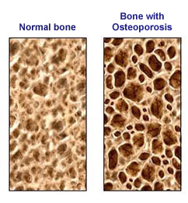
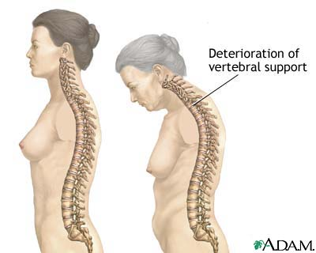
Musculoskeletal System and Aging
Bone thins and weakens
  Estrogen/testosterone deficiencies
  Poor calcium intake
  Insufficient exercise/low peak bone density

Slide 15
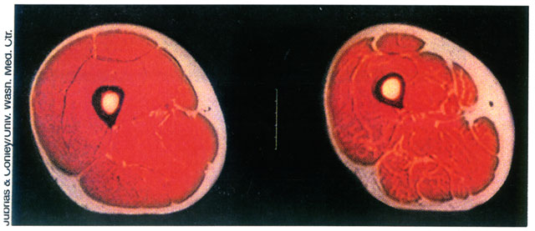
Musculoskeletal System and Aging
Muscle mass and strength decline
  Sarcopenia
    Greek Meaning: “Poverty of Flesh”
  Begins in 4th decade
    Smaller number of type II fast-twitch fibers
    Fewer motor units and synapses
    Cartilage stiffens and declines in strength

Slide 16

Musculoskeletal System and Aging
Muscle mass/strength decline
  Increased risk for disability and loss of function
    Exercise can slow age-related changes!

Slide 17
Becoming Really Old: The Indignities
“The topic of this essay is one of the most dreaded by our society, and, therefore, consideration of it is extremely unpopular. It deals with a contradiction experienced by all of us, from time immemorial: we want to live long, but we do not want to get old. It is a conundrum that we have not been able to resolve. Yet we continue to try, even though we know in the end all our attempts will fail. Denial as a defense may at times appear to succeed, but the success is only temporary. Physical and subsequent psychic changes enforce reality.”
Ruth F. Lax, Psychoanalytic Quarterly, 2008

Slide 18
Chronic Disease in the Elderly
More prevalent in elderly
  Cumulative effect of environment & heredity
Omnipresent
  Cardiovascular & cerebrovascular disease
  Cancer – breast & prostate
  Hypercholesterolemia & hypertension
  Obesity & diabetes
  Osteoarthritis & osteoporosis
  Vision & hearing loss
Increased multisystem disease
  Increases vulnerability to declining health
  Can burden an individual
Notes:
80% of people 65 and older have one or more chronic diseases

Slide 19
Physiological Changes with Aging
Musculoskeletal
Vision
Hearing
Nervous System
Cardiovascular
Respiratory
Gastrointestinal
Endocrine
Renal

Slide 20
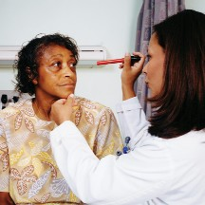
Vision and Aging
Decreased acuity for objects
  Both stationary and moving
  E.g., hitting a baseball
Loss of adaptation to light
  Increased rigidity of the pupil
  E.g., entering a dark theater

Slide 21
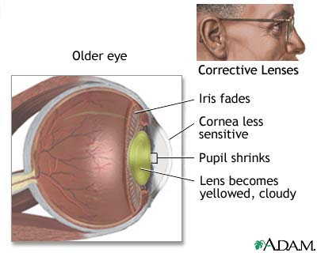
Vision and Aging
Presbyopia
  Greek for “elderly vision”
  The 40 year “atomic clock”
    Eye muscles weaken
    Lens loses elasticity
    Loss of near focus →
      Reading Glasses
Notes:
Presbyopia: The loss of the eye's ability to change focus to see near objects. The word "presbyopia" comes from the Greek for "elderly vision.“ The lens of the eye and the muscle that surrounds it are like atomic clocks, slowly ticking with such precision that a person's age can be determined by measuring their ability to focus close up. Children can focus up to a few inches from faces. The focal length extends as we age, until sometime around age 40, we all need reading glasses.

Slide 22
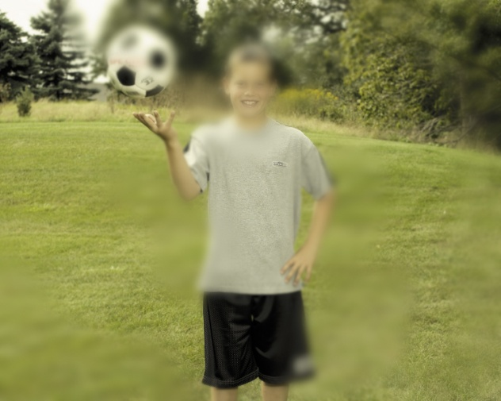


Vision and Aging
Cataracts
  Protein aggregations
  Increasing lens opacity
Glaucoma
  Increased fluid pressure in eye
  Open angle vs. closed angle
Macular Degeneration
  Loss of central vision
  Retinal Drusen deposits
Notes:
>1 million Cataract operations annually in USA. Outpatient procedure; very high success rate. Due to the lack of modern medical technology, world's leading cause of blindness. Over 16 million people.
Glaucoma increases the fluid pressure inside the eye, leading to loss of side vision and eventually total blindness. The increased pressure destroys the optic nerve. With early detection, it can be kept under control with pressure reducing eye drops and surgery. Chances of developing it increase with age. There are over five million people blind from glaucoma worldwide.
Age-related Macular degeneration is a degenerative disease of the macula; the macula is the part of the retina responsible for central vision. There is no way yet of repairing the vision that has been lost, but if detected early laser surgery can help slow the progression of the disease. (AMD) is the leading cause of vision loss in people over age 65. Eight million people are legally blind from macular degeneration worldwide and as the population ages this number is expected to grow.

Slide 23
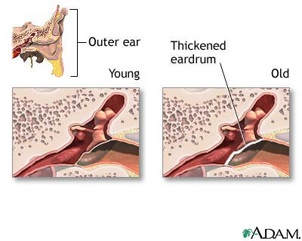
Hearing and Aging
    Eardrum thickens
Degenerative changes
    Inner ear bones/structures
Impaired equilibrium
  Deterioration of labyrinth
Tinnitus

Slide 24
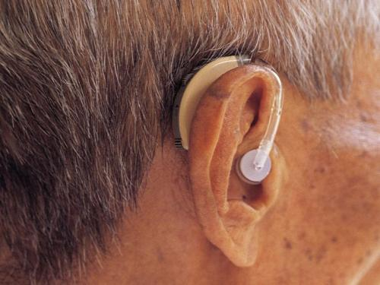
Hearing and Aging
Loss of speech discrimination
  Changes in auditory nerve
Presbycusis
  High-frequency hearing loss
  Due to prior noise exposure
  Affects ~30% > 65

Slide 25
What is Memory?
“Memory” is a mental process:
  Learning
  Storing
  Retrieval
    Recognition
    Recall
“Memory” is part of “Cognition”
  The mental process of knowing
  Awareness, perception, memory, reasoning, judgment
Notes:
What is memory? Memory is a mental process consisting of learning, storing, and then retrieving information. Information can either be spontaneously recalled, or we can be asked to recognize things in the environment.
Memory is part of something larger which we call ‘cognition’. Cognition is the mental process of knowing. Cognition can be broken down into things like awareness, perception, memory, reasoning, and judgment. Memory is a smaller but important part of cognition.

Slide 26
Cognitive Changes: Normal Aging
Slower processing speeds
Word-finding difficulties
  Tip of the tongue
Memory changes
  Names
  Recent events
  Delayed retrieval
Notes:
We know that some cognitive changes occur with normal aging. We see that it takes longer to learn new things, but things can still be learned.
We sometimes experience word-finding difficulties, aka the ‘tip of the tongue’ phenomenon, where you can’t find the name of something, but you can still say what it does and get your point across.
Memory changes also occur with the normal aging process. Aka, ‘senior moments’. For example, after this lecture, I may have trouble remembering where I parked my car. Or if I run into someone I recognize in the parking lot, I may not be able to remember their name.

Slide 27
Cognitive Changes: Normal Aging
RECALL
  Affected by age
  10% decline per decade beginning in midlife
  Still a relatively small effect
RECOGNITON
  Generally remains stable across lifespan with normal aging
Notes:
We recognize this set of photos I showed you just a few moments ago.
This is because delayed RECOGNITON remains relatively stable during the lifespan.
However, RECALL is affected by age. We expect there to be approximately a 10% decline per decade in our recall performance beginning in midlife, with midlife constantly being re-defined, as I’ve shown you with the life expectancy graphs.

Slide 28
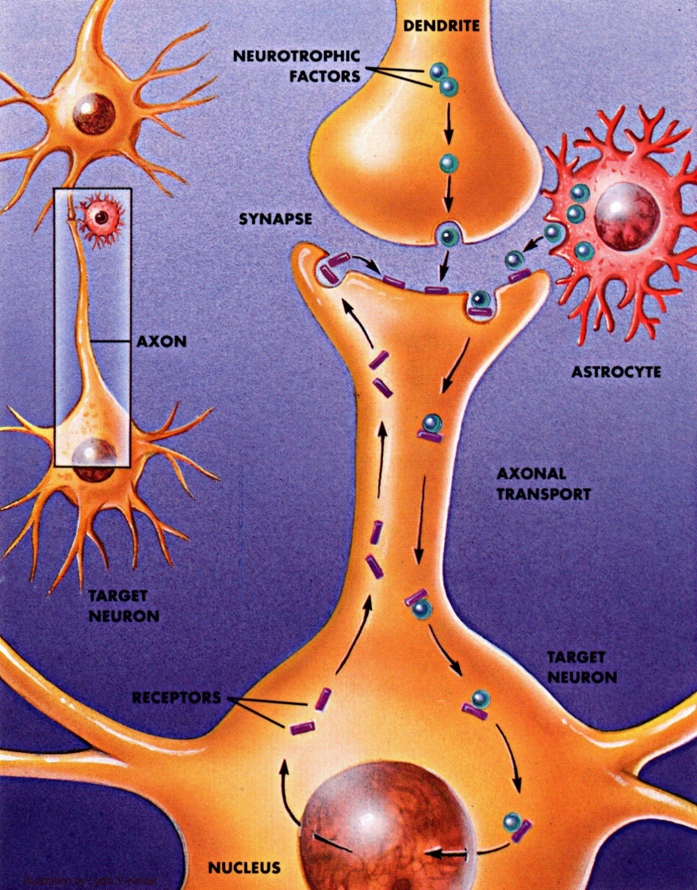
Brain Changes with Aging
Cognitive changes →
Neuronal loss?
  Recent studies refute
    Neurogenesis
    Environ enrichment
      BDNF
Neuronal changes
  Communication
    Synapses
    Neurotransmitters

Slide 29
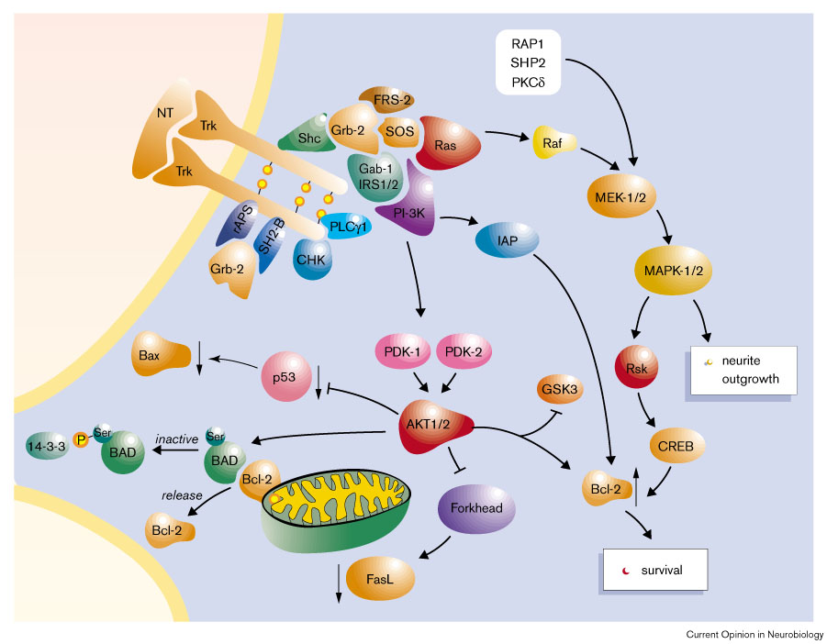
Brain Changes with Aging

Slide 30
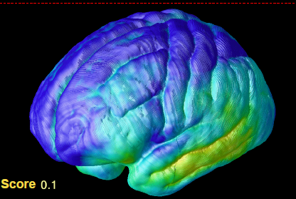
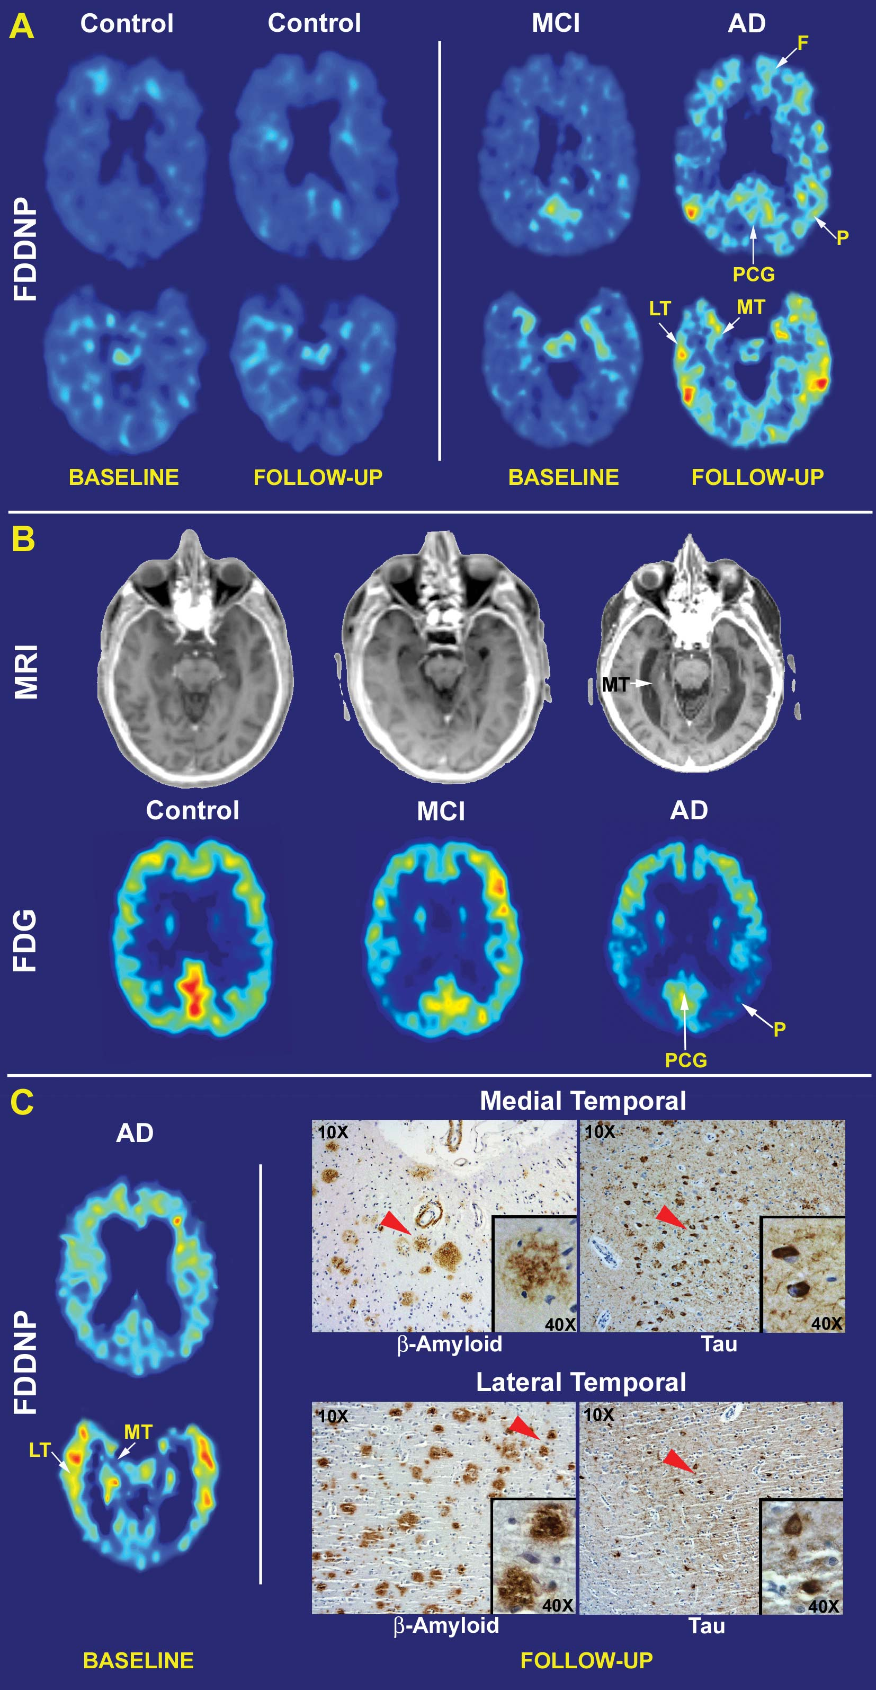
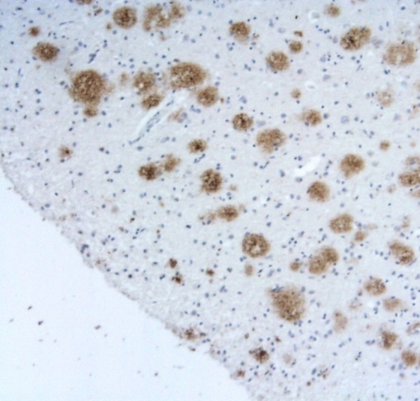
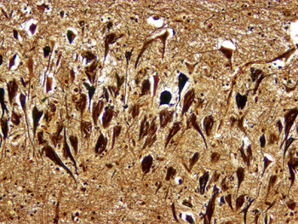
Brain Changes with Aging: Plaques/Tangles
Aging vs. Alzheimer’s
  Location/Amount

Slide 31
Causes of Memory Loss
Normal aging
  Changes in Memory and Cognition
  AD risk 1% per year
Mild Cognitive Impairment (MCI)
  Changes in Memory and Cognition
  Neuropsych testing deficit(s)
  AD risk 10-15% per year
Dementia
  Changes in Memory and Cognition
  Neuropsych testing deficit(s)
  With functional deficits
Notes:
Mood changes can have an additive negative effect on memory.
As can Medications like sleeping pills, anti-anxiety medications, and narcotic pain meds
Medical Illnesses can lead to reversible memory problems with conditions like sleep apnea, thyroid dysfunction, and metabolic or infectious diseases.
And then there is Dementia – definitely not normal aging, dementia is a pathological brain syndrome, with progressive loss of memory and other cognitive functions, serious enough to interfere with performing the tasks of daily life. Dementia can be caused by a number of disease processes, the most common of which is Alzheimer’s disease.

Slide 32
MCI and Dementia are NOT Normal Aging
Memory loss + other cognitive decline(s):
  Aphasia
    Difficulty producing or comprehending
    spoken or written language
  Agnosia
    Loss of ability to recognize objects, persons, shapes, etc.
  Apraxia
    Loss of ability to carry out learned purposeful movements
    Despite having desire and physical ability intact
  Executive dysfunction
    Abstraction, judgment, planning of complex tasks

Slide 33
MCI and Dementia are NOT Normal Aging
  Declines must interfere with daily living:
    Mild-Moderate:
      Working, finances, shopping, cooking, driving
    Moderate-Severe:
      Bathing, dressing, toileting, eating, transferring

Slide 34
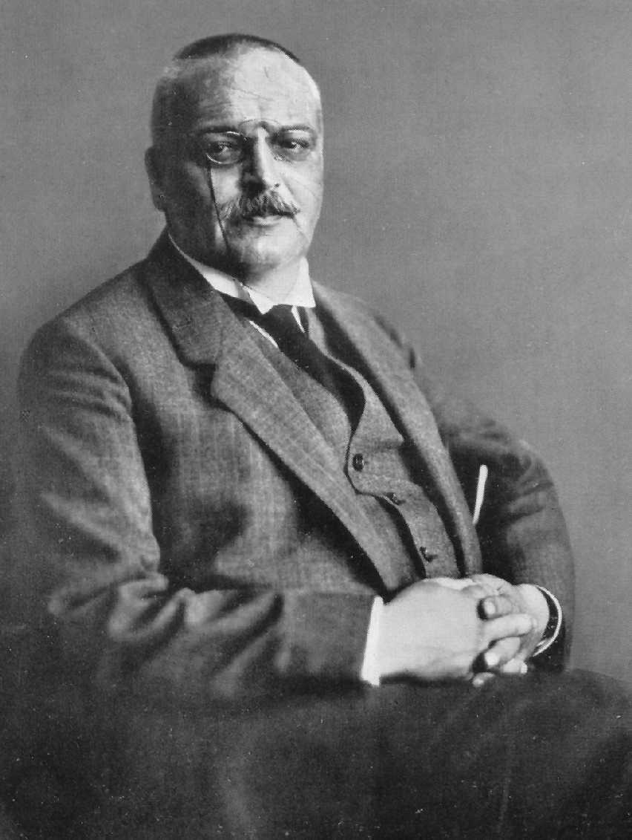
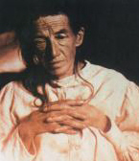
1906: Alois Alzheimer’s first case
German neuropathologist and psychiatrist
  “Peculiar disease of the cerebral cortex”
  Observed patient and analyzed brain
Auguste Deter – institutionalized age 51
  Impaired memory, aphasia, disorientation and ‘psychosocial incompetence’
  Gradually deteriorated → hallucinations
  Died age 54, diagnosis ‘presenile dementia’
    Kraeplin later named disease after Alzheimer
Notes:
Alois Alzheimer described the first case at a psychiatry conference in 1906.
Deter institutionalized at Frankfurt Hospital
“Another irony is that it may have been somebody else who ‘discovered’ Alzheimer’s Disease. The condition had already been described by Oskar Fischer, Francesco Bonfiglio and Graetano Perusini, and it was largely due to Emil Kraepelin, Alzheimer’s boss at the clinic in Munich, that the condition bears Alzheimer’s name. Kraepelin, who first classified schizophrenia, included Alzheimer’s description of Auguste Deter’s symptoms and pathology in the eighth edition of his book Psychiatrie, which was published in 1910. In that book, Kraepelin calls the condition ‘Alzheimer’s Disease’ for the first time. Alzheimer had described Auguste Deter as an example of dementia in a relatively young person, and did not claim to have discovered the disease. He, and others, were surprised that Kraepelin had named the condition ‘Alzheimer’s disease’, but, nevertheless, the name stuck. Kraepelin had probably named the disease after Alzheimer and exaggerated the novelty of the findings to give his institution more prestige, and to ensure the continuation of research grants. 5 years after the publication of Kraepelin’s book, Alzheimer died of tonsilitis-induced nephritis, aged 51.”

Slide 35
Evaluation of Dementia
History and physical examination
Collateral information
Mental status examination
Labs: TSH, B12, folate, RPR, ESR, ?HIV
Imaging: ?CT, MR, PET, SPECT
Neuropsychological battery
Caregiver/psychosocial assessment

Slide 36
Reversible Causes of Dementia
Depression
Metabolic disturbances (thyroid, adrenal)
Vasculitides
B₁₂, folate, thiamine deficiencies
Structural lesions (tumors, stroke)
CNS Infections (syphilis, HIV)
Toxins (alcohol, heavy metals)

Slide 37
Causes of Dementia
Alzheimer’s disease
Vascular dementia
Dementia with Lewy bodies
Frontotemporal dementia
Parkinson disease
Progressive supranuclear palsy
Normal pressure hydrocephalus

Slide 38
Frequencies of Dementia Types

Slide 39
Alzheimer’s Disease
(AD)

Slide 40

Alzheimer’s Disease:
Neuropathology
Amyloid plaques
Neurofibrillary tangles
Neuronal death
  Hippocampal and association corticies
  Nucleus basalis of Meynert (acetylcholine)
  Locus coeruleus (norepinephrine)
  Dorsal raphe nucleus (serotonin)

Slide 41
Alzheimer’s Disease: Neuroimaging
Structural studies (MRI, CT)
  Generalized cortical atrophy
    Hippocampal atrophy
Functional studies (PET, SPECT)
  FDG
    Biparietotemporal hypometabolism/hypoperfusion
  PIB
    Amyloid marker
  FDDNP
    Amyloid and tau marker

Slide 42
Structural MRI and Functional PET
Notes:
Here we see prototypical structural and functional scans of the brain in normal aging, mild cognitive impairment and Alzheimer’s disease. These are 2-dimensional pictures looking down from the top, with the eyes and nose at the top and the back of the head at the bottom. On the top left we see the structually intact and well functioning brain of normal aging. In the middle is a mildly shrunken brain seen in an intermediate condition called Mild Cognitive Impairment, where there is mild memory loss but no problems with daily activities. And on the right we see the severe shrinkage or atrophy caused by Alzheimer’s Disease, most prominent in the medial temporal lobe memory area of the brain. The shrinkage occurs from cell loss. The bottom row is a more advanced ‘functional’ scan of the brain showing the amount of sugar used by the brain to function. A normal brain is able to successfully use higher amounts of sugar, while there is less usage with worsening memory loss.

Slide 43
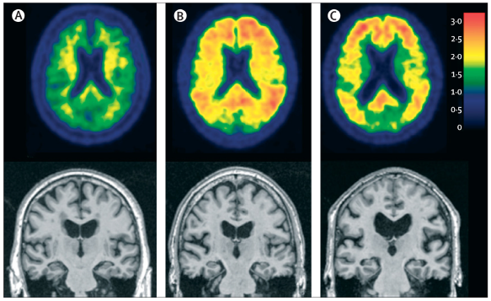
Structural MRI and PIB Amyloid PET
Notes:
Figure 1. Illustration of biomarker staging of Alzheimer’s disease
Three elderly individuals are placed in order from left to right by use of our proposed biomarker staging scheme. (A) A cognitively normal individual with no evidence of Aβ on PET amyloid imaging with PiB and no evidence of atrophy on MRI. (B) A cognitively normal individual who has no evidence of neurodegenerative atrophy on MRI, but has significant Aβ deposition on PET amyloid imaging. (B) An individual who has dementia and a clinical diagnosis of Alzheimer’s disease, a positive PET amyloid imaging study, and neurodegenerative atrophy on MRI. Aβ=β-amyloid. PiB=Pittsburgh compound B.

Slide 44
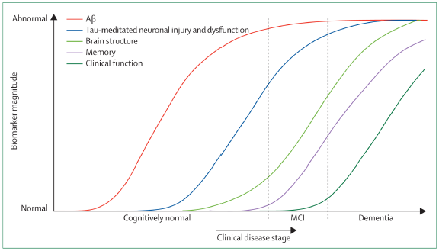
Dynamic Progression of AD Biomarkers
Jack et al., Lancet Neurology, 2010

Slide 45
Alzheimer’s Disease:
Natural Course and Symptoms
Most common cause of dementia
  ~1% affected at age 60
  Dementia risk roughly doubles q5yrs after 65
Typically insidious onset and course
  Onset in late 50s to mid 60s
  Average survival 8-10 years after diagnosis
  7th leading cause of death
Notes:
Dementia mainly affects older people, although there is a growing awareness of cases that start
before the age of 65. After age 65, the likelihood of developing dementia roughly doubles every
five years.

Slide 46
Alzheimer’s Disease:
Natural Course and Symptoms
Memory and Function:
Earlier features
  forgetfulness, word-finding difficulty
  complex tasks
Later features
  amnesia, language
  simple tasks

Slide 47
Alzheimer’s Disease: Pharmacotherapy
Discontinuation of toxic medications
  Sedatives, hypnotics, narcotics, anticholinergics, antihistamines, etc.
Cholinesterase inhibitors
  Donepezil, galantamine, rivastigmine
NMDA antagonist
  Memantine
Psychotropics
  antidepressants, antipsychotics

Slide 48
Polypharmacy
Drugs that may cause psychiatric symptoms
  Depression
    Antihypertensives
      Betablockers
    Anticonvulsants
    Sedative-hypnotics
    Antipsychotics
    Oral contraceptives
    Chemotherapy
  Anxiety
    Stimulants/caffeine
    Antidepressants
    Sedative-hypnotics
  Mania
    Corticosteroids
    Decongestants
    Bronchodialators
  Psychosis
    Anticholinergics
    Antihistamines
    Antiarrhythmics
    Dopamine agonists
    Corticosteroids
    Baclofen
    Etc.

Slide 49
Polypharmacy
Prescribing more meds than clinically appropriate
  Common problem in elderly
    Chronic illnesses
    Frequent doctor usage
  Outpatients average 3-8 drugs
    Target: Less than 6
Consequences
  Adverse drug reactions, interactions, non-compliance
  Increases cognitive impairment, falls, incontinence

Slide 50

Polypharmacy
Concepts for polypharmacy reduction
  Protecting older adults from doctors
  Define benefit for each medication
  Use lowest effective doses
  Monitor for effectiveness and side effects
  Connect pharmacist with physician and patient

Slide 51
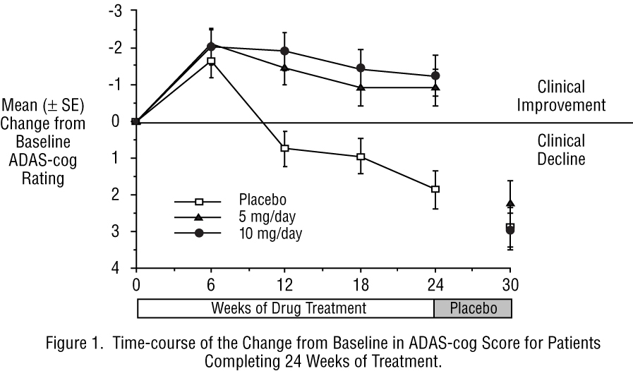
Medications for AD
Donepezil (Aricept)
Notes:
ADAS-cog: 70 pt scale, validated measure of cognition, used in this study to assess mild to moderately demented AD patients.
A 4-point ADAS cog change at 6 months is clinically meaningful for groups. There is no inherent clincal meaning to a 4 point change in ADAS cog for a given patient.

Slide 52
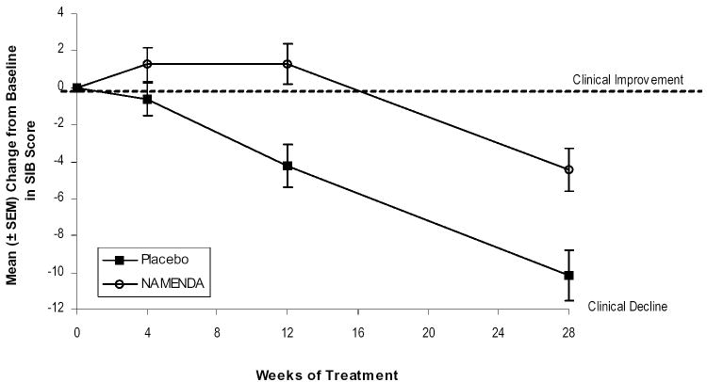
Medications for AD
Memantine (Namenda)
Notes:
Severe Impairment Battery (SIB) – 100 pt scale, a validated measure of cognition in moderate to severe dementia.

Slide 53
Alzheimer’s Disease:
Natural Course and Symptoms
Behavior and Function
Earlier features
  apathy, depression
  complex tasks
Later features
  agitation, wandering, incontinence
  simple tasks

Slide 54
Behavioral Symptoms of AD
First: Treat using non-pharmacologic approaches
  Environmental modification
  Task simplification
  Appropriate activities
Second: Medications for specific target symptoms
  Minimal effective doses
  Trials of tapering once stable
    DART-AD trial

Slide 55
Patient & Family Education & Support
Referral to early-stage groups
Adult day healthcare services
  Appropriate structured activities
    Physical exercise
    Recreation
MedicAlert® + Safe Return®
  For wandering
  Alzheimer’s Association’s

Slide 56
Patient & Family Education & Support
Alzheimer’s Association
  (800) 272-3900 www.alz.org
Caregiver Resource Centers
  (800) 445-8106 www.caregiver.org
UCLA Longevity Center
  Memory Care Program
  http://www.semel.ucla.edu/longevity
OPICA adult day healthcare in Santa Monica
  Optimistic People In a Caring Atmoshphere
  www.opica.org

Slide 57
Books for Dealing with Alzheimer’s
The 36-Hour Day
  Nancy Mace and Peter Rabins
Learning to Speak Alzheimer’s
  Robert Butler, MD
Creating Moments of Joy
  Jolene Brackey

Slide 58
Patient & Family Legal Planning
Discuss importance of basic legal and financial planning as part of the treatment plan as soon as possible after the diagnosis of Alzheimer’s Disease.

Slide 59
Hypothetical Consultation:
“A colleague of a 72-year-old attorney calls because the attorney says that he sees a small dog in the office. He is not distressed by the dog although he does become distressed when others say the dog is not there or step on it by mistake. A staff member reveals that the attorney has experienced a gradual decline for at least two years and that the visions of the dog are not new. The staff member also reports that the attorney has had instances of impaired short-term memory and slowness of thought. There have been no sudden changes in cognition or functioning. He has had some recent falls and slowness in walking. What cognitive disorder is most consistent with the above presentation?”
Adapted from iGPSAP review course, 2009

Slide 60
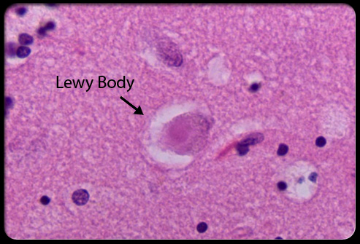
Dementia with
Lewy Bodies
(DLB)
Notes:
Alpha-synuclein inclusion body

Slide 61
DLB: Clinical Diagnostic Criteria
Core features
  Fluctuation in cognition
  Visual hallucinations
  Parkinsonism
Suggestive features
  REM sleep behavior disorder, neuroleptic sensitivity
Supportive features
  Falls, syncope, autonomic dysfunction, delusions, depression

Slide 62
DLB: Neuropathology
Lewy bodies, Lewy neurites (alpha-synuclein aggregates) are graded 0-4 in density
Severity of AD pathology (amyloid plaques, neurofibrilly tangles) and cerebrovascular disease are taken into account

Slide 63
DLB: Neuroimaging
Low dopamine transporter uptake in basal ganglia
Occipital hypometabolism/hypoperfusion

Slide 64
DLB: Psychiatric Symptoms
Visual hallucinations
Delusions
Anxiety
Agitation
Depression
Apathy

Slide 65
DLB: Pharmacotherapy
Parkinsonism
  Levodopa
  Avoid anticholinergics
Neuropsychiatric symptoms
  Cholinesterase inhibitors (rivastigmine)
  Memantine
  Atypical antipsychotics
  SSRIs/SNRIs
  Benzodiazepines
  Melatonin
  Avoid anticholinergics

Slide 66
DLB vs. Parkinson Disease Dementia
In DLB, less than one year separates cognitive decline and development of motor symptoms
Parkinson’s Disease Dementia has prolonged period (i.e., years) of motor symptoms prior to onset of cognitive decline

Slide 67
Another consultation:
A 64 y/o attorney was hospitalized with gradual personality changes, including poor judgment, disinhibition, and inappropriate behaviors.
Family report that he stopped going to work, stopped paying the bills, and ran up large debts on merchandise from QVC. He became impulsive and disinhibited, fondled his wife in public, sexually propositioned his daughters, and uttered uncharacteristic racial slurs at social gatherings. At the same time, he became distractible and hyperactive, with compulsive behaviors, pulling the hair off his arms and exhibiting hyper-oral behaviors such as overeating.
His father and a paternal grandparent had similar dementing illness. Brain scans showed extensive hypoperfusion in both frontal lobes, more extensive in the right hemisphere. The patient meets criteria for ___, probably familial.

Slide 68
Frontotemporal Dementia
(FTD)

Slide 69
FTD: Clinical Features
Earlier onset, typically sixth decade
More rapid course of decline
Neuropsychiatric symptoms common (90%) and more prominent than cognitive impairment
Neuropsychiatric: apathy, disinhibition, emotional blunting, loss of empathy, aggression, antisocial behavior, hyperphagia, repetitive behavior, psychosis, depression
Cognitive: executive dysfunction, nonfluent aphasia

Slide 70
Sociopathic acts in FTD patients:
Unsolicited sexual approach or touching
Traffic violations including hit-and-run accidents
Physical assaults
Shoplifting
Deliberate non-payment of bills
Pedophilia
Indecent exposure in public
Urination in inappropriate public places
Stealing food
Eating food in grocery store stalls
Breaking and entering into others’ homes
Notes:
FTD patients manifest violations of moral rules or norms early in their disease [9]. These patients appear self-centered and do not respond to the needs of others or even acknowledge them. Antisocial behavior, a measure of “immoral behavior,” occurs in more than half of patients with FTD [11].
Investigators have described FTD patients with stealing and shoplifting [10], [12] and [13], inappropriate sexual behavior [14] and [15], physical aggression and acts of violence [12] and [15], frequent traffic violations and hit-and-run accidents [16], and even pedophilia [10]
M.F. Mendez, A.K. Chen, J.S. Shapira and B.L. Miller, An investigation of moral judgment in frontotemporal dementia, Cogn Behav Neurol 18 (2005), pp. 193–197.

Slide 71
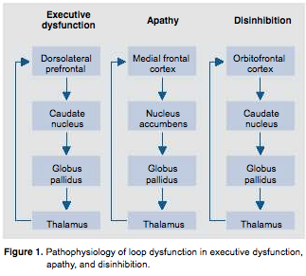
Brain Circuitry Dysfunction in FTD

Slide 72
FTD: Pathogenesis and Neuropathology
Mutations in tau gene (chromosome 17), also found in other neurodegenerative disorders
Aggregation of tau protein into neurofibillary tangles in glial cells in frontal and temporal regions
Neuronal dysfunction and death (mechanism unclear)

Slide 73
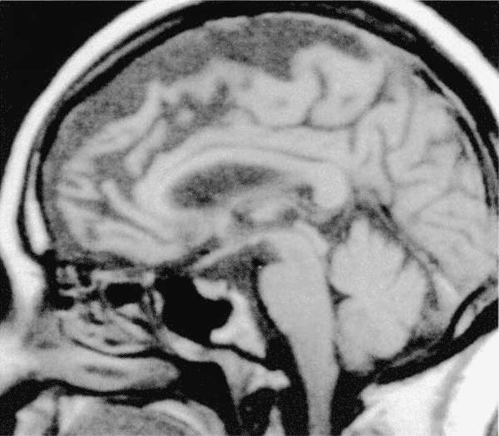
Frontotemporal Atrophy on MRI
Zimmerman et al. Neuroimaging, 2000.

Slide 74
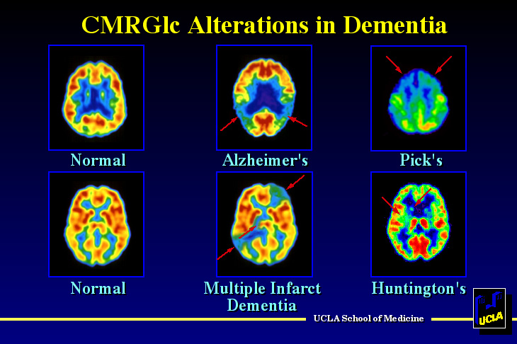
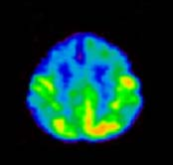
FDG-PET in FTD
Pick’s
Normal
FTD
Phelps et al (eds). Positron Emission Tomography. New York: Raven Press; 1986.

Slide 75
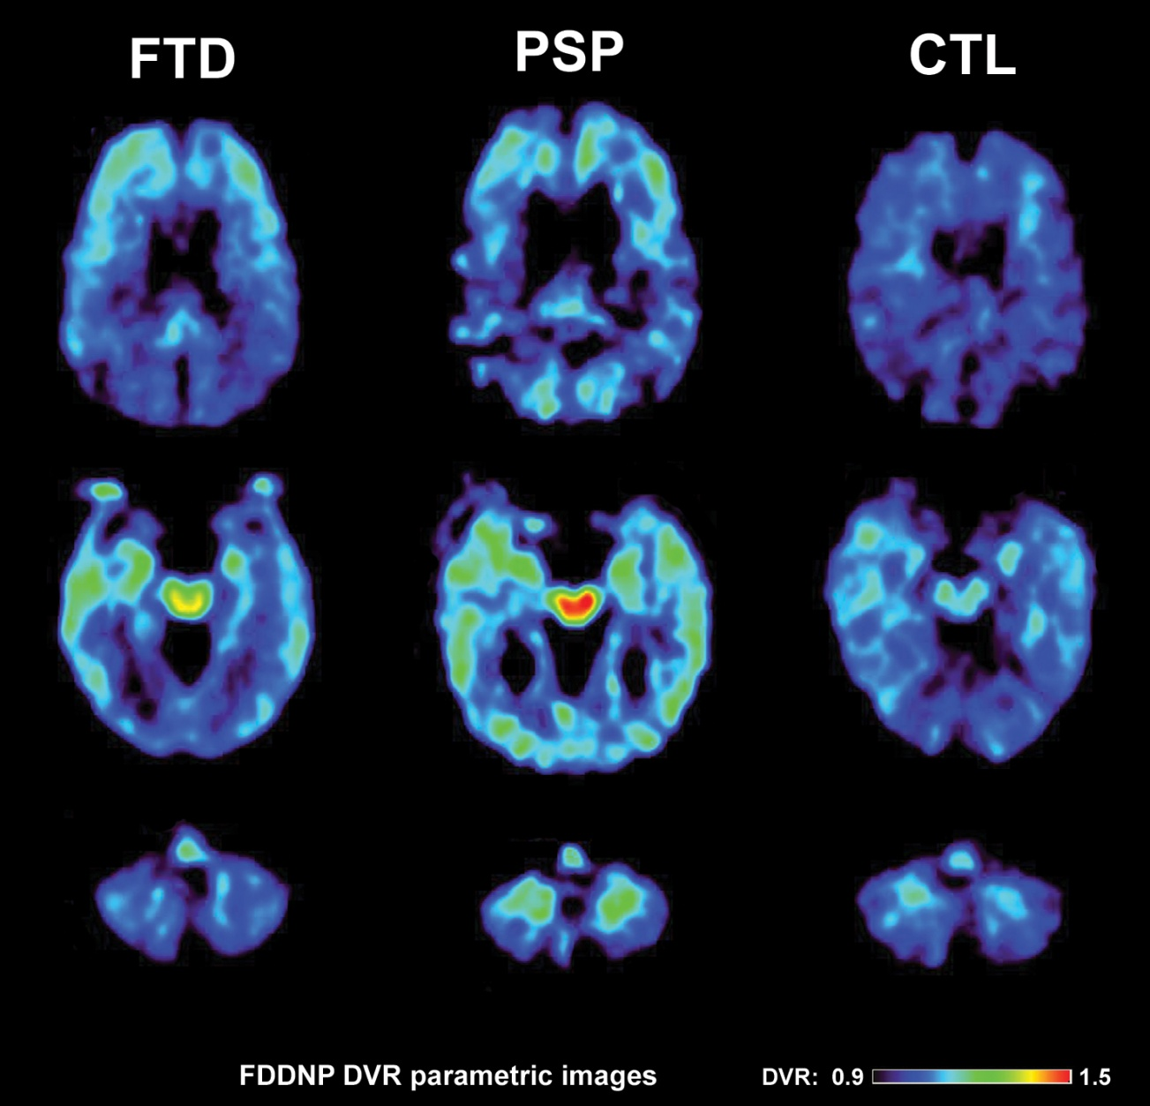
FDDNP-PET in FTD & Progressive Supranuclear Palsy
Notes:
N5-067 Dem Con Template
2/26/2015 10:52 AM
75

Slide 76
FTD: Neuroimaging
Structural: frontotemporal atrophy
Functional: hypometabolism/hypoperfusion in prefrontal and orbitofrontal cortices, cingulate, insula
FDG-PET useful in differentiating FTD vs. AD

Slide 77
FTD: Pharmacotherapy
No evidence for use of cholinesterase inhibitors or memantine
Moderate support for use of SSRIs for depression, disinhibition, aggression, repetitive behaviors, hyperphagia
Weak evidence for use of atypical antipsychotics for psychosis, disinhibition, aggression
No data on anticonvulsants

Slide 78
CNS Conditions and Mood Syndromes
Neurologic
  Alzheimer’s Dementia
  Parkinson’s disease
    Depression most frequent psychiatric complication
      Late developing dementia
  Huntington’s disease
  Stroke (8-75% mood symptoms)
    Left prefrontal & basal ganglia → depression
    Right hemisphere lesions → mania
  Traumatic brain injury
  Multiple sclerosis
  Epilepsy

Slide 79
Summary
Aging results in significant changes in body & brain
Dementia is common in the elderly
Alzheimer’s disease accounts for 70% cases
Significant progress on pathogenesis, clinical distinctions and earlier diagnosis
Effective treatments to slow progression and treat psychiatric symptoms exist, but not satisfactory
Treatment to dramatically change course of illness does not exist
Prevention currently most feasible strategy

Slide 80
Contact Information
David Merrill, MD, PhD
dmerrill@mednet.ucla.edu
310-267-0274
Geriatric Psychiatry Clinic
310-825-9989
University of California, Los Angeles
Semel Institute for Neuroscience & Human Behavior
UCLA Longevity Center
(310) 267-1243

